Slide 1
Overview of ETL

Slide 2
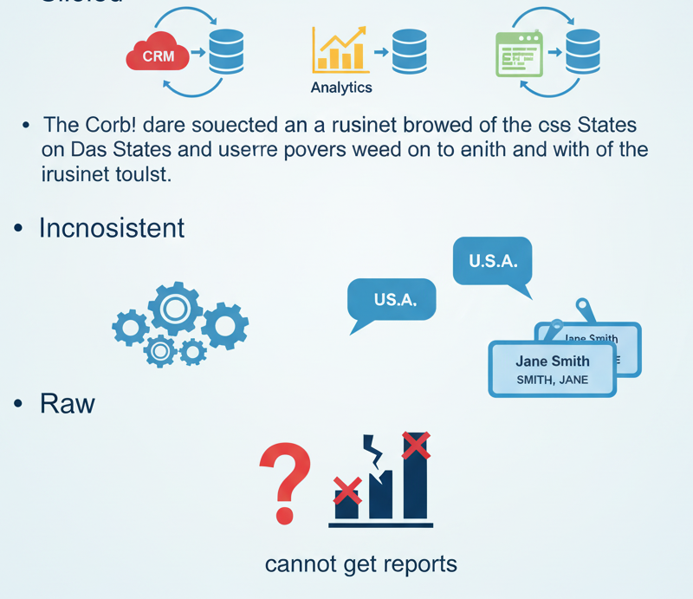
Introduction
Before we define ETL, let's look at the problem it solves. Our business data is:
In different systems that don't talk to each other.
Sales data is in Salesforce.
Marketing data is in Marketo or Google Analytics.
Finance data is in an Oracle database.
Product data is in a SQL Server database.
Inconsistent: The same concept is stored differently.
"USA", "U.S.A.", "United States"
"Jane Smith", "smith, jane"
"Raw": Data is in a format designed for running the business (OLTP), not analyzing it (OLAP).
Result: You can't get a single, trustworthy report to answer simple questions like, "What was our total revenue per product, per region, last quarter?"

Slide 3
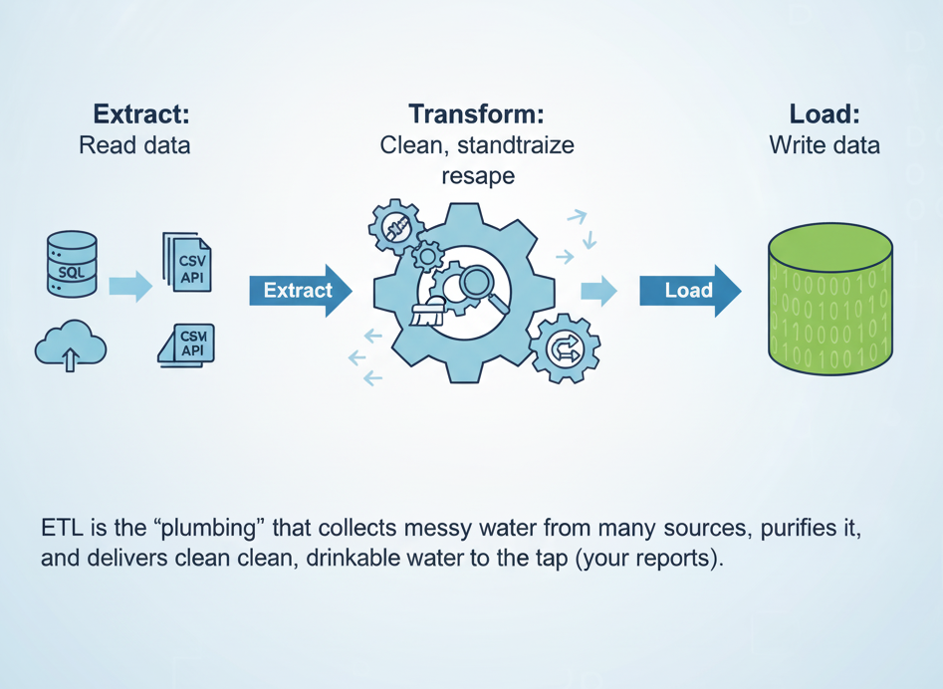
What is ETL?
ETL is the process that solves this problem. It's a three-step data integration process:
Extract: Read data from all the various source systems.
Transform: Clean, standardize, and reshape the data into a consistent, analyzable format.
Load: Write the processed data into a target system, usually a Data Warehouse.
ETL is the "plumbing" that collects messy water from many sources, purifies it, and delivers clean, drinkable water to the tap (your reports).

Slide 4
The "E": Extract
This is the "get the data" step.
Goal: To read data from its original source and pull it into a temporary holding area, known as the Staging Area.
Common Sources:
Databases (OLTP): Like MySQL, Postgres, SQL Server, Oracle (where your app data lives).
Files: CSVs, JSON, XML, log files.
APIs: Cloud services like Salesforce, Google Analytics, Stripe.
Web Scrapers: (Less common, but a source).
Key Challenge: Getting data out efficiently without slowing down the live production systems.

Slide 5
The "T": Transform
This is the "magic" step and the most complex. This is where we create value by turning raw data into clean, usable information.
Goal: To apply all the business rules and logic to the data in the staging area.
Common Transformations:
Cleaning: Fixing errors (e.g., "New Yrok" → "New York"), handling missing values (NULL).
Standardizing: Forcing data into a single format (e.g., all dates become YYYY-MM-DD, all country codes become "USA").
Joining: Combining data from multiple sources (e.g., joining Customer data with Sales data).
Aggregating: Summarizing data (e.g., rolling up 1,000 individual transactions into one "Daily Sales Total" row).
Business Logic: Applying calculations like Profit = Revenue - Cost.

Slide 6
The "L": Load
This is the final step: delivering the finished product.
Goal: To physically move the transformed data from the staging area into the final target, the Data Warehouse or Data Mart.
Target Systems:
Relational Data Warehouses (Teradata, Oracle)
Columnar Cloud Data Warehouses (Snowflake, BigQuery, Redshift)
Two Main Methods:
Full Load: Deletes all data in the target and reloads everything. Simple, but slow. Good for small tables.
Incremental Load (or "Delta Load"): Only adds new or changed data since the last run. This is faster and more efficient.

Slide 7
ETL vs. ELT
ETL (Classic): Extract → Transform (in Staging) → Load.
The "heavy lifting" (Transformation) happens in a separate ETL server.
ELT (Modern): Extract → Load (Raw to Warehouse) → Transform (in Warehouse).
You load the raw data first and then use the power of the cloud data warehouse itself (e.g., using SQL in Snowflake) to do the transformations.
Why is ETL so Important?
ETL is the foundation for all business intelligence and analytics.
Creates a "Single Source of Truth": It integrates all data into one reliable place.
Ensures Data Quality: The "T" step is dedicated to cleaning and validating data, making it trustworthy for decision-making.
Enables Historical Analysis: Operational systems often discard old data. ETL captures it, building a historical record over time (e.g., using Slowly Changing Dimensions).
Improves Performance: Data is pre-shaped and optimized (in a Star Schema) specifically for fast reporting.

Slide 8
Extraction Techniques

Slide 9
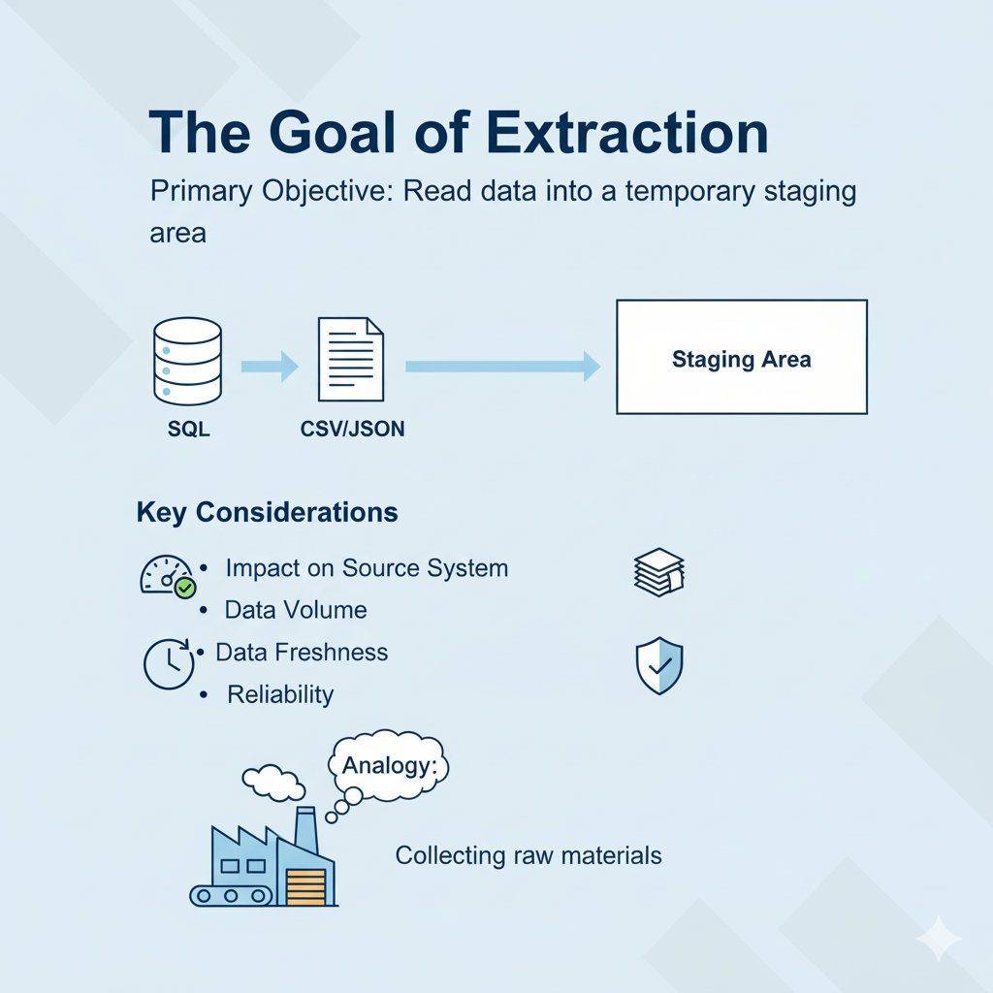
Introduction
To read data from the source systems and bring it into a temporary staging area for further processing.
Key Considerations:
Impact on Source System: Minimize disruption to operational systems (which are running the business).
Data Volume: Efficiently handle potentially massive amounts of data.
Data Freshness: Extract data as frequently as needed (real-time, daily, weekly).
Reliability: Ensure all data is extracted accurately and completely.

Slide 10
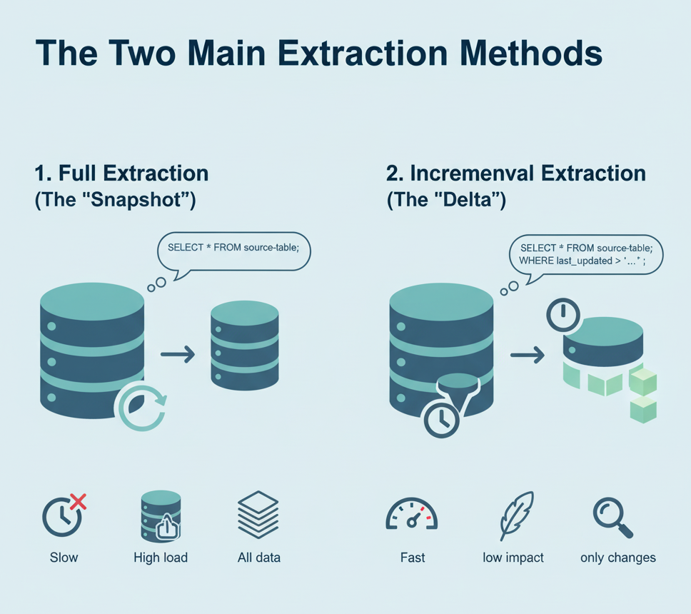
The Two Main Extraction Methods
At a high level, all extraction falls into two categories:
Full Extraction (The "Snapshot")
You copy all the data from the source table every time the ETL process runs.
SELECT * FROM source_table;
Incremental Extraction (The "Delta" or "Change")
You only extract data that is new or has changed since the last ETL run.
This is the preferred method for large tables.

Slide 11
Method 1: Full Extraction
How it works: The ETL process runs a query to dump the entire table. The existing data in the target (or staging area) is completely replaced.
Pros:
Simple: Very easy to implement. No complex tracking is needed.
Complete: Guarantees you have an exact copy (captures deletes implicitly, as they won't be in the new load).
Cons:
High Load on Source: Running SELECT * on a 1-billion-row table can severely impact the production database.
Slow: Takes a long time to run.
High Network Traffic: Moves a huge amount of data.
When to use it:
For the initial, first-time load of a table.
For very small, non-critical tables (e.g., dimension tables like Dim_Categories that only have 50 rows).

Slide 12
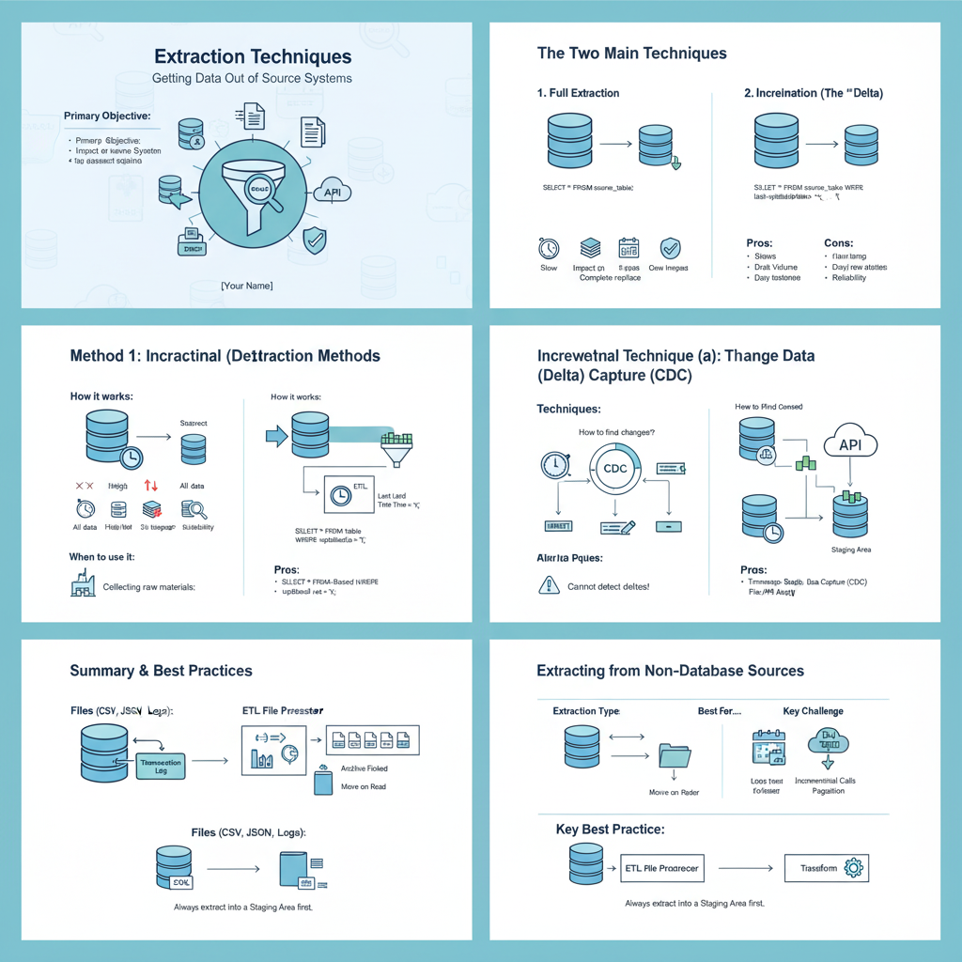
Method 2: Incremental (Delta) Extraction
How it works: The ETL process identifies and extracts
only the changes.
The Big Challenge: How do you reliably find the changes?
We need a mechanism to identify new or updated rows.
This leads to several specific techniques.
Pros:
Fast & Efficient: Runs very quickly as it only deals
with a small subset of data.
Low Impact on Source: A query for "what's new" is
much less stressful on the production database.
Cons:
More Complex: Requires logic to track what was last loaded.
Misses Deletes: Some methods (like timestamps) cannot identify rows that were deleted.

Slide 13
Incremental Technique
(a): Timestamp-Based (Watermarking)
This is the most common incremental technique.
How it works:
The source table must have a timestamp column (e.g., last_updated_date or created_at).
The ETL process saves the last timestamp it successfully loaded (this is the "high-water mark").
The next run, it only asks for data after that timestamp: SELECT * FROM source_table WHERE last_updated_date > '2025-11-03 17:00:00';
It then saves the new "high-water mark" for the next run.
Pros:
Relatively easy to implement.
Works on most standard databases.
Cons:
It cannot detect deletes. If a row is deleted, this query will never find it.
Requires a reliable, accurate timestamp column (which isn't always available).

Slide 14
Incremental Technique
(b): Change Data Capture (CDC)
This is the "gold standard" for high-volume, critical data.
How it works:
Instead of querying the table, this method reads the database's internal transaction log (e.g., MySQL binlog, Postgres WAL).
This log is the database's own "diary" of every single change that happens.
The CDC tool (like Debezium, Fivetran, Qlik Replicate) streams these changes (INSERT, UPDATE, and DELETE) in real-time.
Pros:
Captures Deletes: The only common method that reliably captures deleted rows.
Very Low Impact: Does not query the production tables at all.
Real-Time: Can stream changes as they happen.
Cons:
Highly Complex: Requires specialized tools and deep database knowledge to set up.

Slide 15
Extracting from Non-Database Sources
Not all data is in a database.
Extracting from Files (CSV, JSON, Log Files):
Method: The ETL process scans a directory (like an FTP folder or S3 bucket) for new files.
Tracking: It needs a way to know which files are new.
File Name/Timestamp: Look for files with today's date.
"Move on Read": Process a file, then move it to an archive folder so it isn't read again.
Extracting from APIs (e.g., Salesforce, Google Analytics):
Method: The ETL process makes an API call to the cloud service.
Tracking: Most APIs support incremental logic (e.g., "Give me all records modified since...").
Challenges: Must handle pagination (getting 100 results at a time) and rate limiting (not making too many calls per second).

Slide 16
Summary
Extraction Type | Best For... | Key Challenge
Full Extraction | Small, non-critical tables (e.g., Dim_Category) | Slow, high impact on source
Incremental (Timestamp) | Most large tables where deletes are not critical | Misses deletes, needs a good timestamp
Incremental (CDC) | Critical, high-volume tables (e.g., Fact_Sales) | Very complex to set up
File / API | External and 3rd-party data | Requires file management / API logic
Key Practice: Always extract data into a Staging Area first. Do not transform it on the fly. This decouples your process, makes error handling easier, and allows you to re-run transformations without re-extracting.

Slide 17
Transformation Techniques

Slide 18
What is Transformation?
We have successfully Extracted our raw data into a temporary Staging Area.
The Problem: This raw data is:
Dirty: Contains errors, typos, and NULL values.
Inconsistent: "USA", "U.S.", and "United States" all mean the same thing.
Fragmented: Customer data is in one table, sales data is in another.
Wrong Shape: It's in an OLTP (transactional) structure, not an OLAP (analytical) one.
The Goal: To apply a series of business rules and functions to clean, standardize, integrate, and reshape the data so it is ready to be loaded into our data warehouse.
Analogy: This is the "kitchen" of our data warehouse. Extraction gathered the raw ingredients; Transformation is where we wash, chop, cook, and combine them into a finished meal.

Slide 19
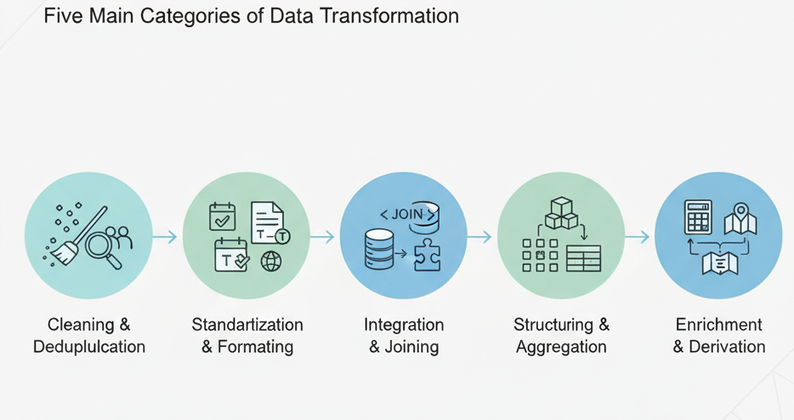
Key Transformation Categories
We can group all transformation techniques into five main categories.
Cleaning & Deduplication: Fixing the "dirty" data.
Standardization & Formatting: Enforcing consistency.
Integration & Joining: Combining different data sources.
Structuring & Aggregation: Reshaping the data.
Enrichment & Derivation: Creating new data from existing data.

Slide 20
Technique 1: Cleaning & Deduplication
To identify and fix or remove bad, incomplete, or duplicate data.
Cleaning:
Handling NULLs: Deciding what to do with missing values.
Replace with 0 (for a number).
Replace with "N/A" or "Unknown" (for a string).
Drop the row entirely if it's unusable.
Correcting Errors: Using rules to fix common typos (e.g., "New Yrok" → "New York").
Fixing Data Types: Converting data to the correct type (e.g., the string "123.50" becomes the number 123.50).
Deduplication:
Identifying rows that are duplicates based on a key (e.g., same CustomerID or Email).
Choosing one "survivor" record (e.g., the most recently updated one) and discarding the rest.

Slide 21
Technique 2: Standardization & Formatting
To ensure all data values for a given attribute are consistent.
Formatting: Forcing data into a single, defined format.
Dates: 10/01/2025 and Jan 10, 2025 both become 2025-10-01.
Strings: "john smith" and "JOHN SMITH" both become "John Smith" (Proper Case).
Numbers: 1,234.50 and $1234.5 both become 1234.50.
Standardizing (Conforming): Mapping multiple different values to a single, standard business value.
Example: "USA", "U.S.", "America", and "United States" all become "USA".
This is almost always done using a Lookup Table (or "reference table") that stores the mapping rules.

Slide 22
Technique 3: Integration & Joining
To combine data from multiple, fragmented sources to create a single, unified view.
How it works: This is the classic database JOIN operation.
Example:
Source 1: Sales table from your e-commerce system (has CustomerID, ProductID, SalesAmount).
Source 2: Customer table from your CRM system (has CustomerID, CustomerName, State).
Transformation: You JOIN these two tables on CustomerID.
Result: A single, "wider" table in your staging area that has ProductID, SalesAmount, CustomerName, and State all in one row. This is a critical step for building your fact and dimension tables.

Slide 23
Technique 4: Structuring & Aggregation
To reshape the data to fit the target data model (like our Star Schema).
Aggregation: Summarizing data from a low level to a higher level. This massively reduces data volume and improves report speed.
From: 1,000 individual transaction rows from a cash register.
To: 1 row for "Total Daily Sales per Store" (SUM(SalesAmount) grouped by StoreID and Date).
Pivoting / Unpivoting:
Pivot: Turning rows into columns (e.g., a table with Month and Sales rows becomes one row with columns like Jan_Sales, Feb_Sales, Mar_Sales).
Unpivot: The reverse. Turning columns (like Jan_Sales, Feb_Sales) into rows.

Slide 24
Technique 5: Enrichment & Derivation
To create new data columns that don't exist in the source systems, adding business value.
Derivation (Calculated Columns): Applying business logic to create new measures.
Profit = SalesAmount - CostAmount
DeliveryTime (Days) = ShipDate - OrderDate
Age = CURRENT_DATE - BirthDate
Enrichment (Lookups): Using data from one field to add more information.
Looking up a ZipCode in a reference table to add City, State, and Region.
Looking up a ProductKey to get the ProductCategory and Department. (This is how you build your dimensions).

Slide 25
Summary
Transformation is the most complex and valuable part of ETL.
It's not one single action, but a pipeline of many techniques.
Key Techniques:
Cleaning (Fixing NULLs, errors)
Standardizing (Formatting, conforming)
Integrating (Joining sources)
Structuring (Aggregating, pivoting)
Enriching (Calculating Profit, looking up State)
All this work happens in the Staging Area to protect source
systems and allow for reprocessing.

Slide 26
Loading Techniques

Slide 27
What is the "Load" Step?
Our data has been Extracted from sources and Transformed in the staging area. It is now clean, consistent, and in the correct shape (Star Schema).
The Goal: To physically move this prepared data from the staging tables into the final, permanent tables in the data warehouse.
Key Considerations:
Speed & Performance: We need to load millions of rows quickly.
Data Integrity: The load must be reliable. We can't lose or corrupt data.
Minimizing Downtime: The warehouse should remain available for users to query.
This is the "final delivery" that makes the data visible to business users.

Slide 28
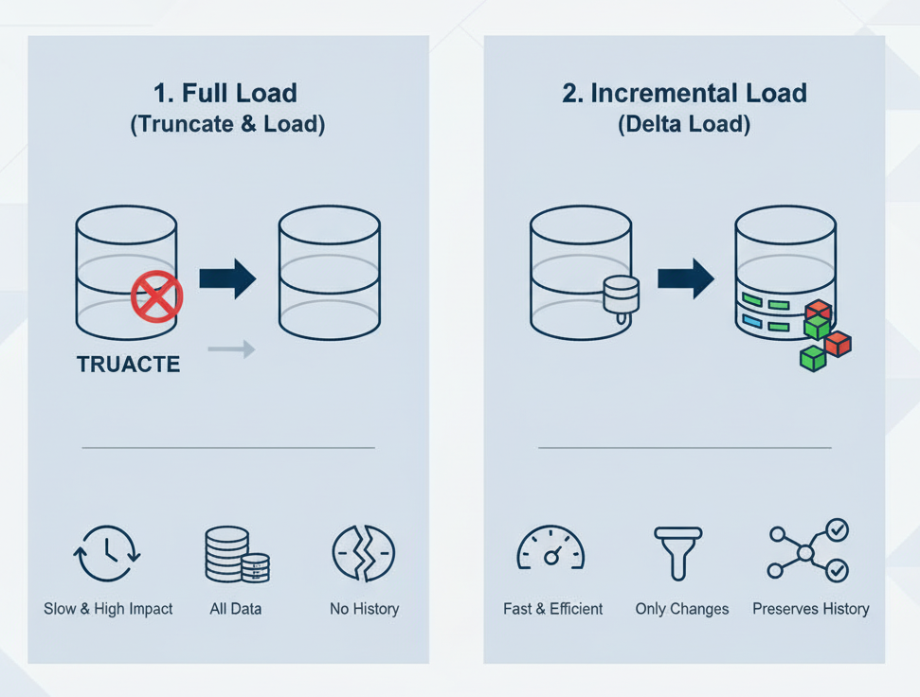
The Two Main Load Methods
Just like extraction, loading data falls into two main categories:
Full Load (or "Truncate and Load")
Deletes all existing data in the target table and replaces it with the new data.
TRUNCATE TABLE Dim_Product; followed by INSERT INTO Dim_Product...
Incremental Load (or "Delta Load")
Only adds new rows or updates existing rows that have changed. It leaves all other data alone.
This is the standard, preferred method for large tables.

Slide 29
Method 1: Full Load (Truncate & Load)
How it works:
TRUNCATE TABLE Dim_Product; (This is a fast way to delete all rows).
INSERT INTO Dim_Product SELECT * FROM Staging_Product;
Pros:
Very Simple: Easy to manage, no complex logic needed.
Handles Deletes: Automatically removes data that is no longer in the source (since you're reloading everything).
Cons:
Extremely Slow: Not feasible for a 1-billion-row fact table.
Loses History: Destroys all historical versions in your dimension tables (breaks SCD Type 2).
Causes Downtime: The table is empty and unavailable for a period.
When to use it:
Only for small, non-historical dimension tables (e.g., a Dim_Status table with 5 rows).
For the very first, initial load of the warehouse.

Slide 30
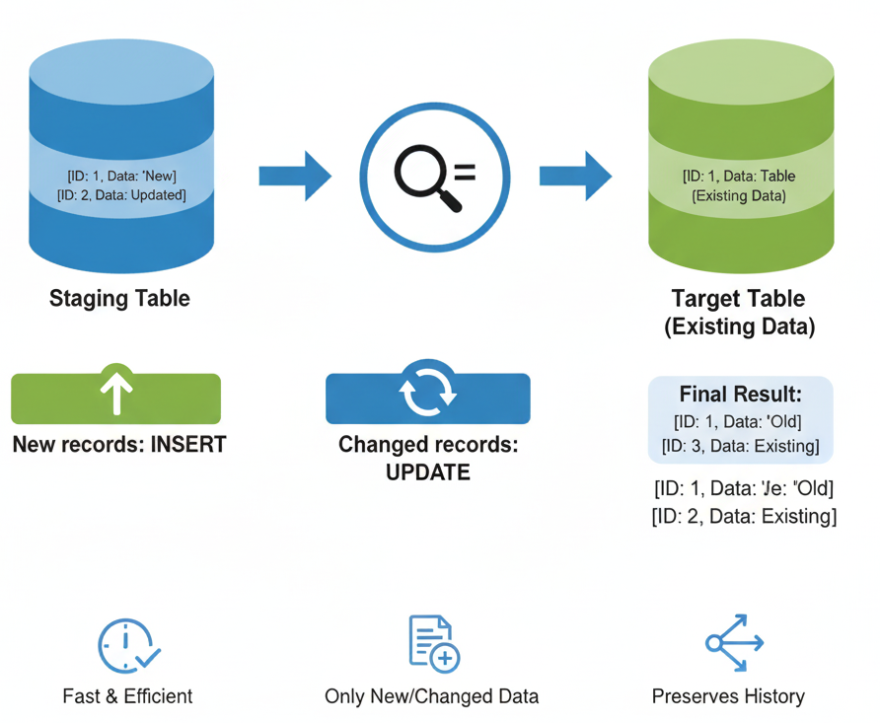
Method 2: Incremental Load
How it works: Compares the (new) data in the staging table against the (old) data in the target table and applies only the differences.
Pros:
Fast & Efficient: Loading 10,000 new rows is much faster than reloading 1 billion.
Preserves History: This is the only way to properly manage Slowly Changing Dimensions (SCDs).
High Availability: The table remains online and queryable during the load.
Cons:
More Complex Logic: You have to write logic to identify what's new (INSERT), what's changed (UPDATE), and what's gone (DELETE).

Slide 31
Incremental Load Type 1: Simple Insert (Append)
This is the simplest incremental load. You only add new rows. You never update or delete old ones.
How it works: INSERT INTO Fact_Sales SELECT * FROM Staging_Sales;
(You assume the staging table only contains new records you haven't loaded before).
When to use it:
This is the standard method for loading transactional fact tables.
Fact table rows represent events (like a sale). Events are permanent and are never "updated." You just keep appending new ones.

Slide 32
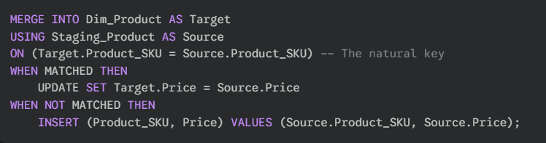
Incremental Load Type 2: Update/Insert ("Upsert")
Definition: This load handles data that can be new or changed. If the record exists, update it. If it's new, insert it.
How it works: Most databases provide a MERGE command for this.
When to use it:This is the standard method for loading SCD Type 1 dimensions (where you just overwrite the old value).

Slide 33
Incremental Load Type 3: Complex SCD Type 2 Logic
This is the most complex load, as it involves INSERTs and UPDATEs to manage historical rows.
How it works (Simplified):
Compare Staging to Target.
If a row is new: INSERT the new row into Dim_Customer as IsCurrent = 'Yes'.
If a row has changed:
UPDATE the old row in Dim_Customer to set IsCurrent = 'No' and EndDate = 'Today'.
INSERT the new version of the row from Staging as IsCurrent = 'Yes' and StartDate = 'Today'.
This logic is almost always handled by an ETL tool to manage the complexity.

Slide 34
Load Performance & Best Practices
Use Bulk Loading: All databases have a special "bulk load" utility (e.g., COPY INTO in Snowflake, bcp in SQL Server). These are much faster than row-by-row INSERT statements.
Drop & Rebuild Indexes: For very large loads, it's often faster to:
Drop all indexes on the fact table.
Load the data (which is fast with no indexes).
Rebuild the indexes.
Load Fact Tables Last: Always load your dimensions first. You need the new dimension surrogate keys (e.g., ProductKey) before you can load the fact table that uses them.
Use Partitioning: On very large fact tables, you can load data into a specific "partition" (e.g., the partition for the current month), which is much faster than a standard load.

Slide 35
Key Transformation Categories
Load Type | Target Table | How it Works | Purpose
Full Load | Small Dimensions | TRUNCATE + INSERT | Simplicity; replaces all data.
Incremental (Append) | Fact Tables | INSERT only | Adds new transactions.
Incremental (Upsert) | SCD Type 1 Dims | MERGE (Insert/Update) | Overwrites changes.
Incremental (Complex) | SCD Type 2 Dims | INSERT + UPDATE | Manages historical rows.

Slide 36
Error handling & reprocessing

Slide 37
Introduction
ETL jobs will fail. It's not a question of if, but when.
Relying on a "perfect run" every time is not a strategy—it's a liability.
Common Causes of Failure:
Source Data: Unexpected values (Price = -100), data type changes (OrderDate becomes a string), or missing files.
System Failure: The network goes down, the source database is offline, the API limit is reached, or the target disk is full.
Logic Bugs: The transformation code itself has a bug (e.g., divide-by-zero error).
A robust ETL process is defined by how well it handles—and recovers from—these failures.

Slide 38
Two Main Types of Errors
It's crucial to differentiate why a job failed.
System / Process Errors
These are "all-or-nothing" failures.
Examples: Cannot connect to the source database, network connection lost, API key is invalid, target warehouse is down.
Handling: There is no data to process. The job must stop immediately and send an alert to the data engineering team.
Data Errors
These are "row-by-row" failures. The system is fine, but the data is bad.
Examples: A SalesAmount column contains the text "N/A", an OrderDate is in the future, a ProductID lookup fails (no matching product).
Handling: You should not fail the entire 10-hour job for one bad row.

Slide 39
Error handling Strategy
1. Abort on Error
The simplest strategy. The moment any error occurs (system or data), the entire ETL process stops.
Pros:
Ensures that "bad data" never, ever enters your data warehouse.
Simple to implement.
Cons:
Extremely fragile. A single, non-critical error (like one bad row in a 50-million-row batch) can halt your entire data update, leaving the business with no new data.
When to use it:
During initial development and testing.
For critical system errors (like a failed connection).
For very small, critical dimension loads where 100% accuracy is required.

Slide 40
Error handling Strategy
2. Redirect Bad Rows
The most common and robust strategy for handling data errors.
How it works:
The ETL job processes one row at a time.
If a row transforms successfully, it's passed on to the "Load" step.
If a row fails transformation (e.g., bad date), it is not dropped.
Instead, it is redirected to a separate "Exception Table" (or "Error Log").
The "Exception Table" stores the bad row, the time of the error, and the reason it failed (e.g., "Failed date conversion").
Pro:
The main job succeeds and loads 99.9% of the good data. The business is happy, and you have a clean "to-do" list of bad data to fix.

Slide 41
Auditing & Logging (The "Control Table")
You need a "receipt" for every ETL run. This is often called a Control Table or Audit Log.
For every job run, you must log:
ProcessName
StartTime / EndTime / Duration
Status (Succeeded, Failed)
RowsExtracted
RowsTransformed
RowsLoaded
RowsRejected (This is the count of rows sent to the exception table)
Why?
This is your main diagnostic tool. If RowsExtracted = 10,000 but RowsLoaded = 9,500, you know your RowsRejected should be 500, and you can immediately check the exception table.

Slide 42
Reprocessing (The "How to Fix")
An error happened. Now what?
Scenario 1: System Error (Job Aborted)
Fix: A human fixes the system (e.g., brings the database online, fixes the network).
Reprocess: The entire job is simply re-run.
This requires your job to be "idempotent"—meaning it can be run multiple times without creating duplicates (e.g., by using MERGE or TRUNCATE/LOAD).
Scenario 2: Data Error (Rows in Exception Table)
Fix: This can be manual or automated.
Manual: A data steward reviews the exception table, fixes the data in the source system, and then flags the rows as "Ready to Reprocess."
Automated: A separate, smaller ETL job runs only on the exception table, applies more complex cleaning rules, and tries to load the fixed data.
This prevents you from having to re-run the entire 50-million-row job.

Slide 43
Alerting & Monitoring
Your ETL job fails at 3 AM. How do you know?
Alerting (Reactive):
Sends an automated email, Slack, or PagerDuty alert to the data team only when a job fails or the RowsRejected count is above a set threshold.
A silent ETL job should be a successful one.
Monitoring (Proactive):
A dashboard (e.g., in Grafana, Power BI) that visualizes your Audit Log.
It should show the health of all ETL jobs, their last successful run, and the number of errors over time.
This helps you spot trends (e.g., "Why are we suddenly getting 100 errors from this source every day?").

Slide 44
Summary
Expect Failure: Design for it. Never assume a "perfect run."
Separate Your Errors: Handle "all-or-nothing" System Errors (abort) differently from "row-by-row" Data Errors (redirect).
Use Exception Tables: Don't fail a 10-hour job for one bad row. Redirect errors and load the good data.
Log Everything: Use an Audit/Control table to track rows in, out, and rejected.
Make Jobs Rerunnable (Idempotent): Your "fix" for a system failure should be as simple as clicking "Run" again.
Automate Alerts: Don't watch your jobs run. Let them tell you when they fail.

Slide 45
ETL Architecture and Workflow Design

Slide 46
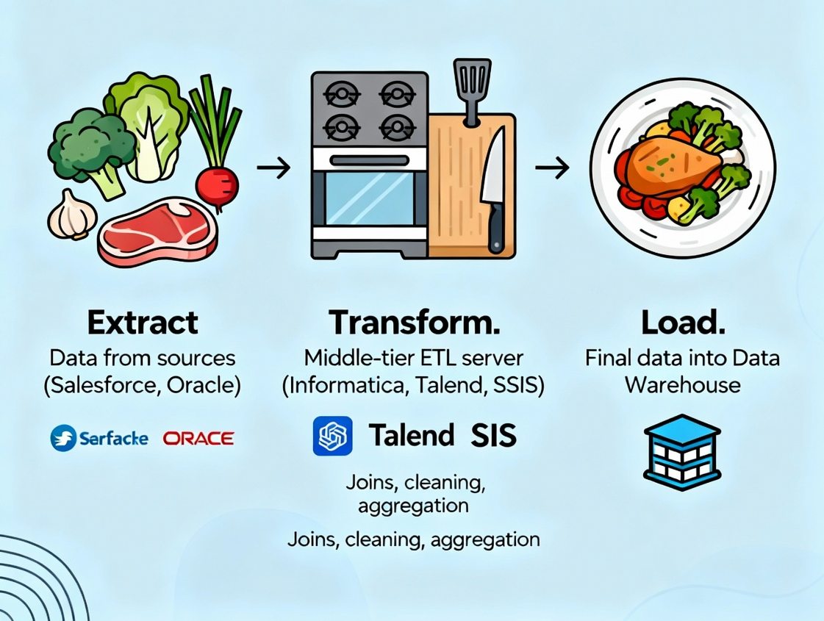
What is ETL Architecture?
ETL Architecture defines the components and the connections of your data pipeline. It's the high-level map of your system.
There are four essential components:
Source Systems: Where the data comes from (databases, files, APIs).
Staging Area: A temporary storage area where data is extracted and transformed. This is the most critical architectural component.
ETL Engine: The "software" or "code" that does all the work (e.g., an ETL tool like Informatica, a custom Python script, or SQL).
Target Warehouse: The final destination for the clean data.

Slide 47
The Critical Role of the Staging Area
You must have a staging area. It is a temporary, private workspace for the ETL process.
Why not E-T-L all at once? (e.g., read from source, transform in memory, load to target)
Decoupling: The staging area decouples your processes. You can Extract all your data first, then Transform it. If the transform fails, you can restart it without re-extracting from the source (which may be slow or offline).
Performance: Transforming complex data (like joining multiple large tables) is much faster inside a database (the staging area) than in a row-by-row memory engine.
Auditing & Reprocessing: The staging area is where you can validate data, log errors (to an exception table), and reprocess failures.
The staging area is your "workbench." You don't build a car in the middle of the highway; you bring the parts to your garage (staging) first.

Slide 48
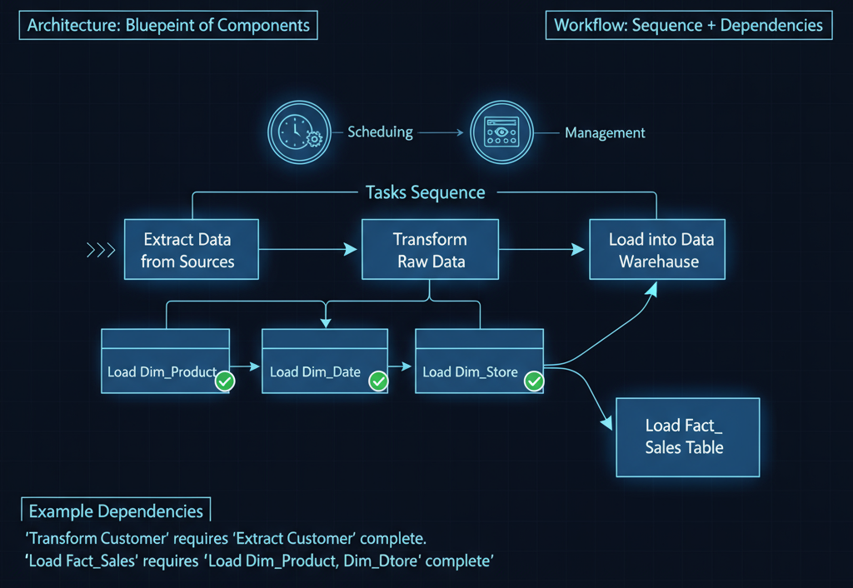
What is Workflow Design?
"Architecture" is the blueprint of the components. "Workflow Design" is the set of instructions for how and when data moves through them.
Workflow: A sequence of tasks and their dependencies.
Orchestration: The process of scheduling, managing, and monitoring these workflows.
Example: You can't start the "Transform Customer" task until the "Extract Customer" task is complete. You can't load the Fact_Sales table until all the dimension tables (Dim_Product, Dim_Date, Dim_Store) are loaded.
Workflow design defines these dependencies.

Slide 49
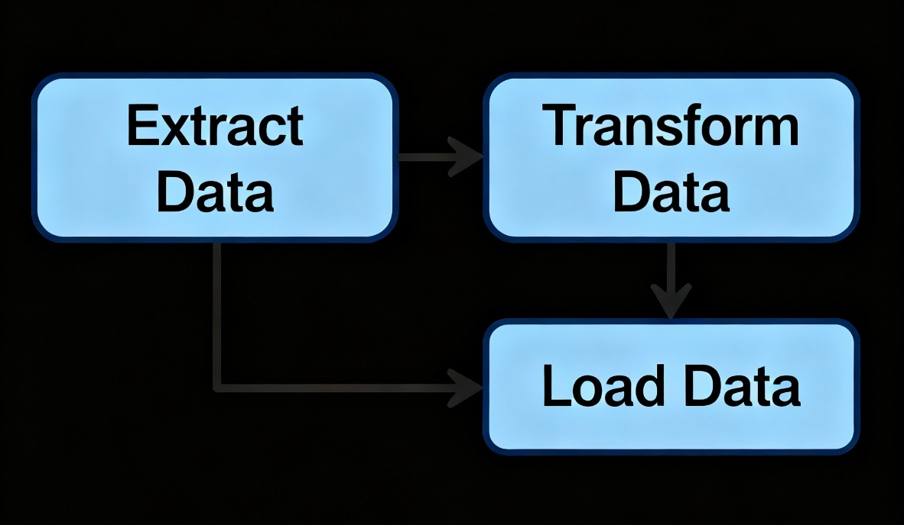
Visualizing Workflows: The DAG
Workflows are commonly visualized as a DAG (Directed Acyclic Graph). This is a fancy term for a flow chart that doesn't have loops.
Directed: Arrows show the flow in one direction.
Acyclic: The flow never circles back (a task can't depend on itself).
Graph: It's a map of tasks.
This DAG is the "recipe" for your ETL. An orchestration tool (like Airflow, Prefect, or a simple SQL Server Agent) is the "chef" that follows the recipe.

Slide 50
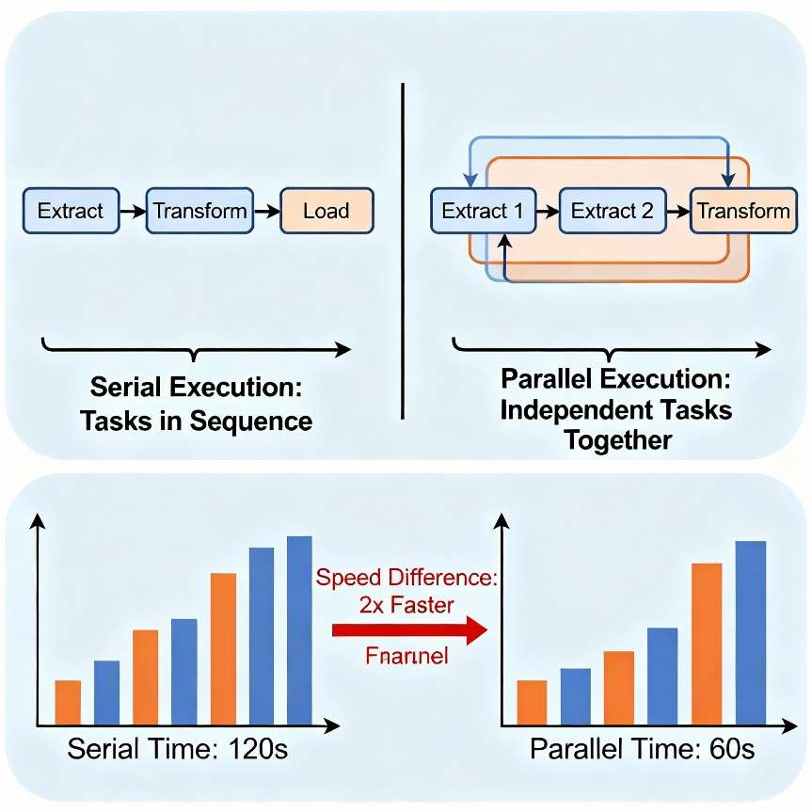
Workflow Design: Serial vs. Parallel
How you structure your workflow (your DAG) has a huge impact on performance.
Serial Execution: Tasks run one after another. This is safe but slow.
Extract A → Extract B → Extract C → Transform
Parallel Execution: Independent tasks run at the same time. This is much faster.
You can extract from Customers, Products, and Sales all at the same time, because they don't depend on each other.
Once all three are finished, the "Transform" task can begin.
Good workflow design maximizes parallel execution for independent tasks.

Slide 51
Architectural Patterns: Batch vs. Streaming
Your architecture also defines when data flows.
Batch Architecture (Most Common)
This is the classic ETL.
The workflow runs on a schedule (e.g., once every night at 2 AM).
It processes data in large batches (e.g., "all of yesterday's sales").
Pro: Simple, reliable, highly efficient for large volumes.
Con: Data is not real-time (it's up to 24 hours old).
Streaming (Real-Time) Architecture
This is for "fast data."
The workflow is always on. It processes data one event at a time as it happens.
Uses tools like Kafka, Kinesis, Spark Streaming.
Pro: Data is available in seconds or minutes.
Con: Much more complex and expensive to build and maintain.
Hybrid: Many companies use Batch for most reports (finance, inventory) and Streaming for a few specific dashboards (e.g., live website monitoring).

Slide 52
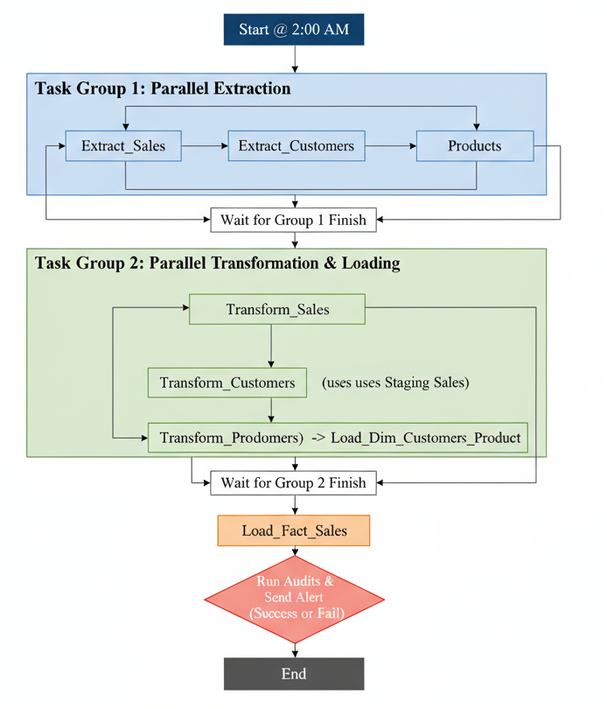
Example: A Nightly Batch Workflow (DAG)
Here is a high-level design for a nightly sales data warehouse load:
Start @ 2:00 AM
Run in Parallel (Task Group 1):
Extract_Sales
Extract_Customers
Extract_Products
Wait for Group 1 to Finish
Run in Parallel (Task Group 2):
Transform_Sales (uses Staging Sales)
Transform_Customers (uses Staging Customers) → Load_Dim_Customer
Transform_Products (uses Staging Products) → Load_Dim_Product
Wait for Group 2 to Finish
Run Final Task (Task Group 3):
Load_Fact_Sales (This must wait for all dimensions to be loaded first)
Run Audits & Send Alert (Success or Fail)
End

Slide 53
Summary
Architecture: Defines the what (components).
Workflow: Defines the how and when (the flow).
Use a Staging Area: Always. It's the most important component for decoupling, reprocessing, and performance.
Orchestrate with a DAG: Map out your dependencies. Don't just chain scripts together and hope.
Parallelize Your Workflow: Run independent tasks (like extracting from different sources) at the same time.
Choose the Right Pattern: Use Batch for most analytics. Only use complex Streaming when the business has a true, high-value, real-time need.

Slide 54
ETL Tools

Slide 55
What is an ETL Tool?
An ETL tool is a specialized software platform designed to manage all aspects of the ETL lifecycle: Extract, Transform, and Load.
Core Purpose: To replace the need for custom, hand-coded scripts (like thousands of lines of Python or SQL).
Key Features:
Visual Interface: A drag-and-drop canvas to design data pipelines (DAGs).
Pre-built Connectors: "Plugs" that easily connect to hundreds of sources (Salesforce, SAP, Oracle, S3, APIs).
Transformation Engine: A library of pre-built functions (joins, lookups, pivots, cleaning).
Orchestration & Scheduling: A built-in scheduler to run jobs (e.g., nightly, hourly).
Monitoring & Alerting: Dashboards and alerts for failed jobs.

Slide 56
The Big Question: Build vs. Buy?
Before choosing a tool, every team faces this question:
Build (e.g., Custom Python/SQL)
Pros:
Total Flexibility: You can do anything. No limitations.
No Cost: The "tool" is open-source (Python, SQL).
Cons:
High Development Cost: Requires a team of skilled data engineers.
Slow to Build: What a tool does in 10 minutes (like a new Salesforce connector) could take your team 2 weeks to build.
Hard to Maintain: You have to build your own scheduler, error handling, and monitoring.
Buy (e.g., Commercial ETL Tool)
Pros:
Speed to Market: Build and deploy complex pipelines fast.
Lower Technical Barrier: Analysts can often build simple pipelines.
Enterprise-Ready: Comes with security, monitoring, and support.
Cons:
License Cost: Can be very expensive.
"Black Box": Can be less flexible than pure code.

Slide 57
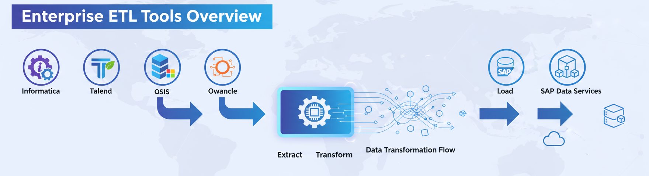
Category 1: Traditional ETL Platforms (GUI-based)
These are the established, all-in-one "powerhouse" tools, often used in large enterprises.
How they work: They are "ETL" focused. They extract data, transform it in their own powerful server engine, and then load the result.
Key Players:
Informatica PowerCenter
Talend (has a popular open-source version)
Microsoft SSIS (SQL Server Integration Services)
Oracle Data Integrator (ODI)
SAP Data Services
Best for: Complex, large-scale enterprise data warehousing with on-premise systems (like SAP or Oracle databases).

Slide 58
Category 2: Modern ELT & Data Integration (Cloud-first)
These modern tools are built for the cloud and embrace the ELT (Extract, Load, Transform) paradigm.
How they work:
Extract: Uses pre-built connectors to pull data from sources (like Stripe, Salesforce, Postgres).
Load: Immediately loads the raw data into your cloud warehouse (Snowflake, BigQuery, Redshift).
Transform: You then run transformations inside the warehouse using SQL.
Key Players (Data Integration/EL):
Fivetran
Stitch
Airbyte (open-source)
Key Players (Transformation):
dbt (Data Build Tool): The new standard for the "T" step. It allows you to write, test, and manage all your SQL transformations.
Best for: Modern, cloud-based data stacks.

Slide 59
Category 3: Orchestration & Code-Based Tools
These tools are for teams that prefer the "Build" (code-first) approach but need a robust platform to schedule, run, and monitor their code.
How they work: You write your E, T, and L logic in Python or SQL. The tool's job is to define the workflow (the DAG) and manage the execution.
Key Players:
Apache Airflow: The most popular open-source option. Workflows are defined in Python.
Prefect: A popular modern alternative to Airflow.
Dagster
Best for: Data engineering teams that need maximum flexibility and want to treat their data pipelines as "code" (DataOps).

Slide 60
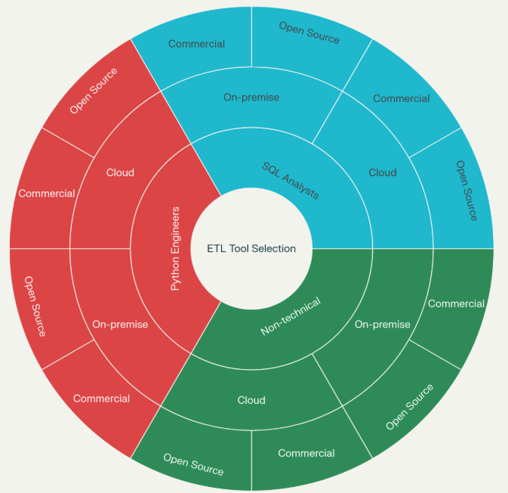
How to Choose the Right Tool?
There is no "best" tool. It depends on your:
Team's Skills:
Do you have SQL analysts? (Use ELT + dbt)
Do you have Python engineers? (Use Airflow)
Do you have non-technical users? (Use a GUI tool like Talend)
Architecture:
Are you on-premise? (Use Traditional ETL like SSIS, Informatica)
Are you in the cloud? (Use Modern ELT like Fivetran + dbt)
Data Sources:
Do you have common cloud sources (Salesforce, etc.)? (Fivetran, Stitch are easy).
Do you have complex, custom, or old on-premise apps? (Informatica, Talend have better connectors for these).
Budget:
No budget? (Use open-source: Python + Airflow + dbt)
Have a budget? (Commercial tools offer speed and support).

Slide 61
Summary
Category | Primary Paradigm | How it Works | Key Tools
Traditional ETL | ETL (GUI-based) | Transforms data in its own server. | Informatica, Talend, SSIS
Modern Integration | ELT (Cloud-based) | Loads raw data, then transforms in-warehouse. | Fivetran, Stitch, Airbyte (for EL) dbt (for T)
Orchestration | Code-based (Build) | Manages and schedules your custom scripts (Python/SQL). | Apache Airflow, Prefect

Slide 62
Best Practices in ETL Design

Slide 63
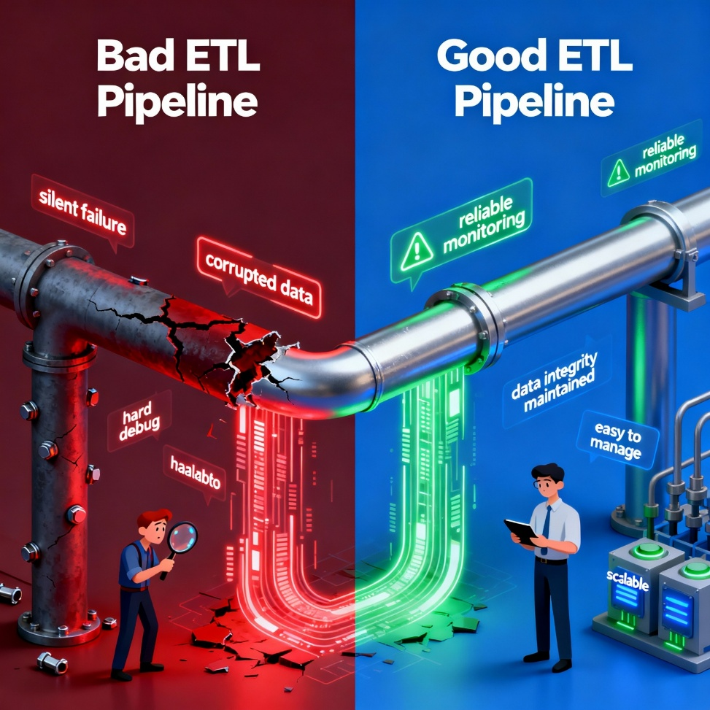
Why Best Practices Matter
We've learned the "what" (E, T, L) and the "how" (tools, architecture).
This presentation is the "why" and "should"—the rules that separate fragile pipelines from robust ones.
A "Bad" Pipeline:
Fails silently.
Corrupts data (e.g., creates duplicates).
Is hard to debug.
Needs a full redesign for every new request.
A "Good" Pipeline:
Is Reliable: Alerts you on failure and protects data integrity.
Is Maintainable: Easy to debug, change, and manage.
Is Scalable: Can handle growing data volumes.

Slide 64
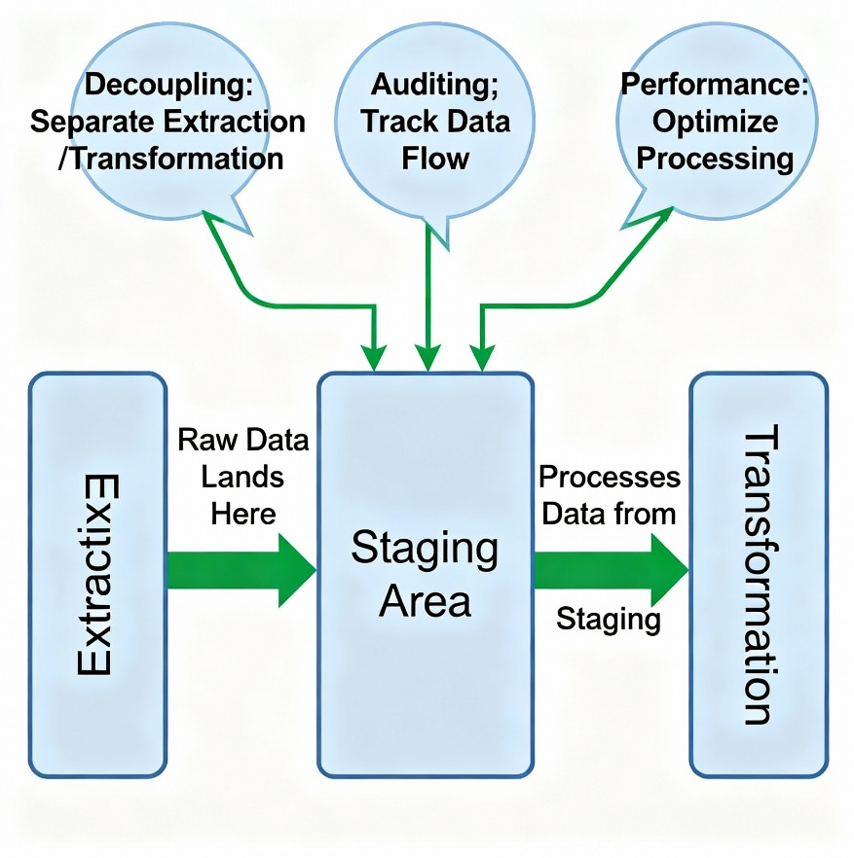
Practice 1: Always Use a Staging Area
This is the most important architectural rule. Do not transform data in memory as you extract it.
Extract raw data and land it in a Staging Area first. Then, run transformations from the staging area.
Why?
Decoupling: You can re-run a failed transformation without re-extracting from the source (which might be slow or offline).
Auditing: You have a place to land data "as-is" to compare before/after the transformation.
Performance: You can leverage the power of a database (staging) for complex joins and transformations, which is faster than row-by-row processing.
Extraction

Slide 65
Practice 2: Load Incrementally, Not Fully
AVOID: TRUNCATE TABLE Fact_Sales; every night. This is slow, high-risk, and causes downtime.
PREFER: Incremental (delta) loading.
Fact Tables: Use an "Append" strategy (only INSERT new rows).
Dimension Tables: Use "Upsert" (MERGE) for SCD Type 1 or full SCD Type 2 logic for history.
Why?
Speed: Loading 1 million new rows is 1000x faster than reloading 1 billion old rows.
Low Impact: Puts minimal stress on the target data warehouse.
Availability: The data warehouse remains online and queryable during the load.

Slide 66
Practice 3: Make Your Jobs Idempotent (Rerunnable)
Idempotent: An operation that can be run multiple times without changing the result beyond the initial run.
The Goal: If your job fails at 3 AM (e.g., network error), the on-call engineer should be able to just "click run again" without worrying.
Bad (Not Idempotent): INSERT INTO Fact_Sales... If you run this twice, you get duplicate data.
Good (Idempotent): MERGE INTO Dim_Customer... You can run a MERGE 100 times, and the result is the same.
How: Use MERGE, check for existing data, or use staging tables to control the final load

Slide 67
Practice 4: Handle Errors Gracefully
Do NOT fail a 10-hour job for one bad row.
DO implement "Redirect on Error."
Good rows are loaded into the target warehouse.
Bad rows (e.g., "N/A" in a date column) are sent to an Exception Table with an error message.
Why?
Resilience: The pipeline succeeds and delivers 99.9% of the data.
Accountability: You have a clean "to-do" list of bad data to fix at the source.

Slide 68
Practice 5: Log Everything (Audit & Control)
Your ETL process shouldn't be a "black box." You need a receipt for every run.
Create an Audit Table (or "Control Table") and log:
JobName & RunID
StartTime, EndTime
Status (Success/Failed)
RowsExtracted
RowsLoaded
RowsRejected (from your exception table)
Why?
Diagnostics: When a job fails, you know where and why.
Monitoring: You can build a dashboard to see the health of your pipelines.
Reconciliation: You can prove that RowsExtracted = RowsLoaded + RowsRejected.

Slide 69
Practice 6: Parallelize Your Workflow
Don't run tasks in a long, single-file line (serially) if you don't have to.
Do identify independent tasks and run them in parallel.
Example:
You can Extract Customers, Extract Products, and Extract Sales all at the same time.
You must wait for Load Dim_Product to finish before you can Load Fact_Sales. (This is a dependency).
Why?
Drastically reduces your total ETL runtime. A 10-hour serial job might become a 4-hour parallel job.

Slide 70
Practice 7: Never Hardcode. Parameterize
Bad: SELECT * FROM sales WHERE order_date = '2025-11-03'
Good: SELECT * FROM sales WHERE order_date = @RunDate
What to parameterize?
Dates: The "as of" date for the run.
Connections: Database server names, usernames, passwords (store these in a secure "vault," not in the code).
File Paths: C:\dev\ vs. /prod/data/
Why?
Portability: You can promote your code from Development (Dev) to Testing (Test) to Production (Prod) by only changing the parameters, not the code.
Maintainability: Easy to update a connection string in one place.

Slide 71
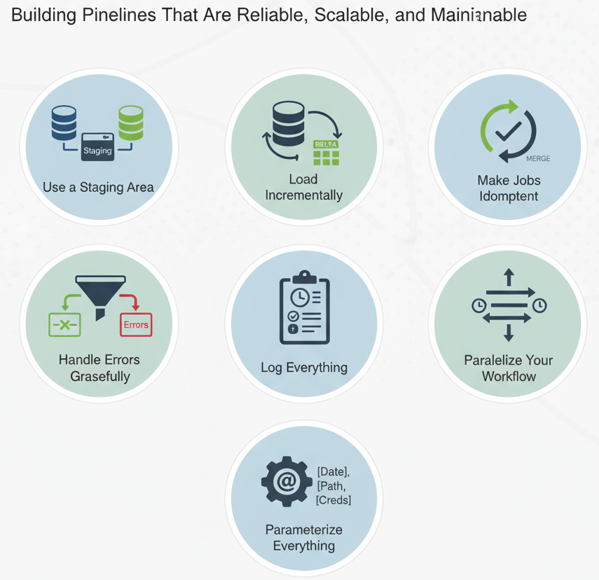
Summary
Use a Staging Area: Decouples your pipeline.
Load Incrementally: Faster, safer, and preserves history.
Make Jobs Idempotent: Allows for safe, easy reruns.
Handle Errors Gracefully: Redirect bad rows; don't fail the job.
Log Everything: Create an audit log for monitoring and diagnostics.
Parallelize Your Workflow: Don't run tasks serially if you don't have to.
Parameterize Everything: Never hardcode.
Following these rules will result in a data pipeline that is Reliable, Scalable, and Maintainable.

